Slide 1
CLUSTERING ASSIGNMENT
Created by : Rajat Shakya

Slide 2
Clustering Assignment Overview
Problem Statement:
HELP International is an international humanitarian NGO that is committed to fighting poverty and providing the people of backward countries with basic amenities and relief during the time of disasters and natural calamities. It runs a lot of operational projects from time to time along with advocacy drives to raise awareness as well as for funding purposes.
After the recent funding programs, they have been able to raise around $10 million. Now the CEO of the NGO needs to decide how to use this money strategically and effectively. The significant issues that come while making this decision are mostly related to choosing the countries that are in the direst need of aid.
Objective:
Categorize the countries using some socio-economic and health factors that determine the overall development of the country
Suggest the countries which the CEO needs to focus on the most

Slide 3
Analysis Approach
Data Quality Check:
Importing the data and cleaning it.
Checked for null values
Come of the columns such as imports, exports, and health were in percentage of GDP. Changed them to values by multiplying it with GDP
EDA: Univariate / Bivariate Analysis
Did Univariate and Bivariate Analysis for checking the data relations with each other.
Outlier Treatment
We detected outliers and did the capping method to remove them.
.01 for lower capping
.99 of upper capping
Scaling
standardizing all the continuous variable
Check the cluster tendency: Hopkin's Test
This was used check the tendency of the data to form clusters

Slide 4
Analysis Approach
Find the best value of K: SSD, Silhouette Score
Identified the suitable value of K with the help of silhouette analysis and elbow curve method.
Using the final value of k, perform final KMeans Analysis
Visualize the cluster using a scatter plots
Perform Cluster profiling: GDPP, CHILD_MORT, and INCOME
Identifying the countries in dire need of fund
Hierarchical Clustering
Single Linkage: Dendrogram
Complete Linkage: Dendrogram
Use one of them for the final clusters
Visualize using the scatter plot
Perform Cluster profiling: GDPP, CHILD_MORT, and INCOME
Identifying the countries in dire need of fund
Decision Making and Recommending the CEO the countries to focus

Slide 5
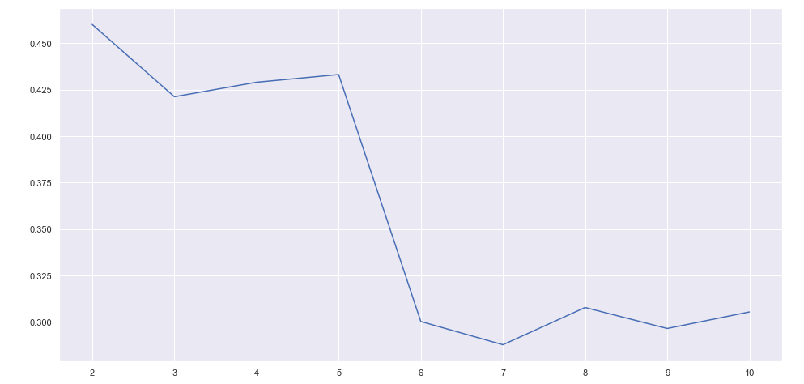
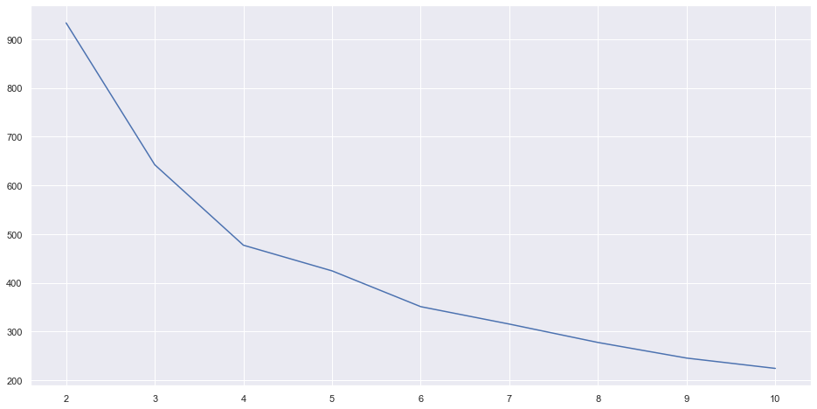
K-means Clustering Visualization
Silhouette Analysis
Elbow Curve
We can see that in the peak point in 2 in both, but we will not take that as it will not give the correct outcome and is never good for clustering.
While, we would take 3 as elbow curve has an elbow at 3. Also, it the best suitable for our clustering for countries

Slide 6
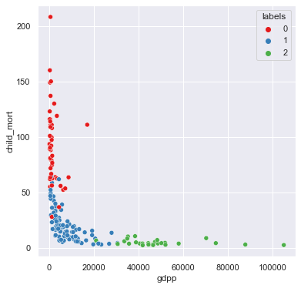
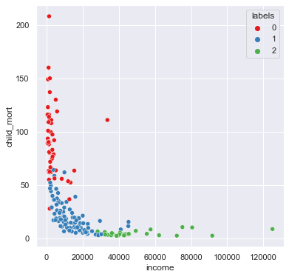
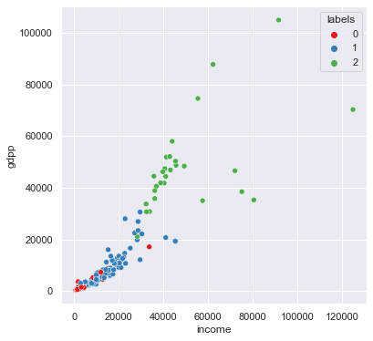
K-means Clustering Visualization
We can see that cluster label 0 has high child mortality, low income, and low GDPP.
Inference:
- Developed countries: Labels 2
- Developing countries: Labels 1
- Under-developed countries: Labels 0

Slide 7
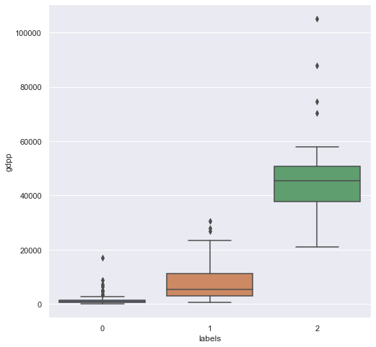
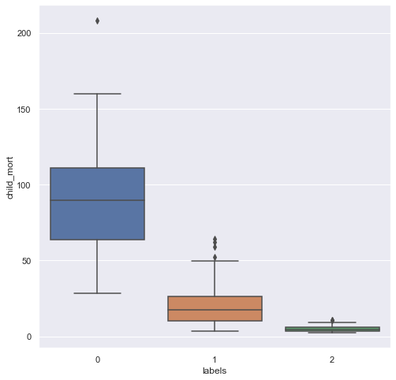
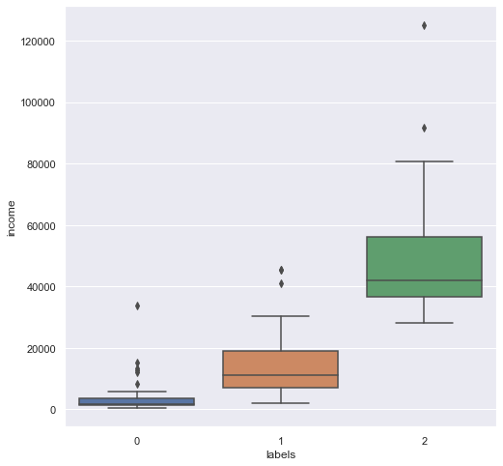
K-means Clustering Visualization
We can see that cluster label 0 has high child mortality, low income, and low GDPP.
Inference:
- Developed countries: Labels 2
- Developing countries: Labels 1
- Under-developed countries: Labels 0

Slide 8
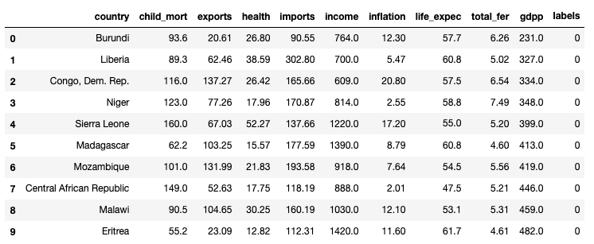
K-means Clustering Results
Top 10 countries obtained from K-Means Clustering that are in dire need for aid.
In this we have sorted GDPP in ascending, income in ascending, and child mortality in descending order.

Slide 9
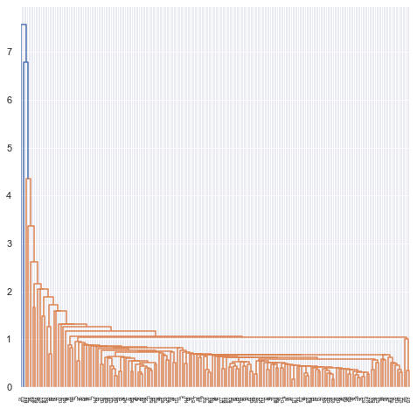
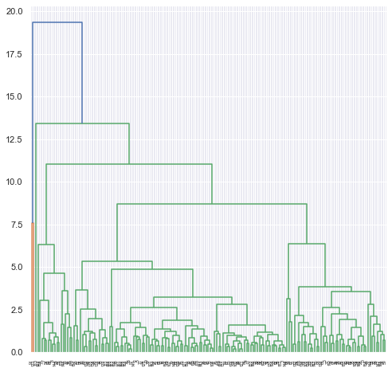
Hierarchical Clustering Analysis
We are not able to find clusters properly using single linkage. However, from complete linkage we can see clear clusters. Also, by looking at dendrogram of hierarchical clustering there seem to be 3 main clusters.

Slide 10
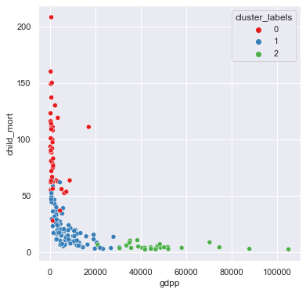
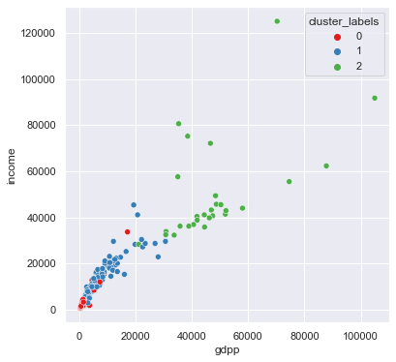
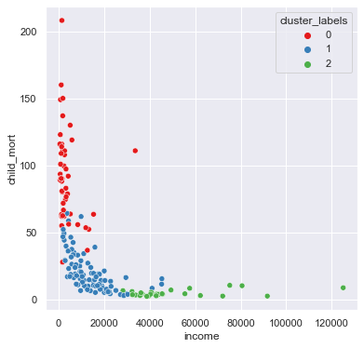
Hierarchical Clustering Visualization
We can see that cluster label 0 has high child mortality, low income, and low GDPP.
Inference:
- Developed countries: Labels 2
- Developing countries: Labels 1
- Under-developed countries: Labels 0

Slide 11
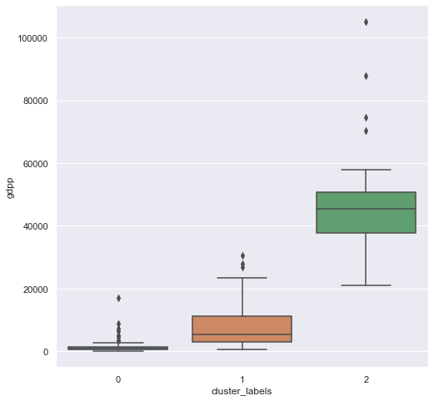


Hierarchical Clustering Visualization
We can see that cluster label 0 has high child mortality, low income, and low GDPP.
Inference:
- Developed countries: Labels 2
- Developing countries: Labels 1
- Under-developed countries: Labels 0

Slide 12
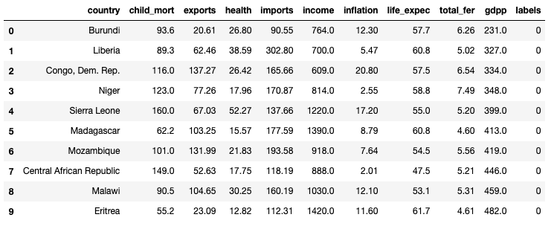
Hierarchical Clustering Results
Top 10 countries obtained from K-Means Clustering that are in dire need for aid.
In this we have sorted gdpp in ascending, income in ascending, and child mortality in descending order.

Slide 13
Summary
Final list of countries which are in direst need of aid are:
Burundi
Liberia
Congo, Dem Rep
Niger
Sierra Leone
Madagascar
Mozambique
Central African Republic
Malawi
Eritrea
We got same list of countries by both K-means and Hierarchical clustering.

Slide 14
Thank You

